Slide 1

Comparing and Contrasting Celtic and Roman homes and items from their daily lives

Slide 2
Sort the animals into groups in any way you can

Slide 3
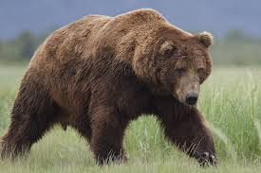
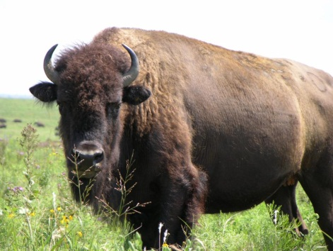
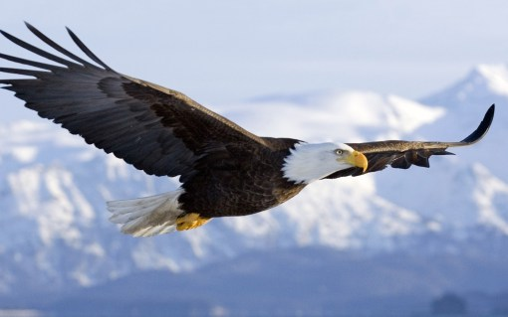
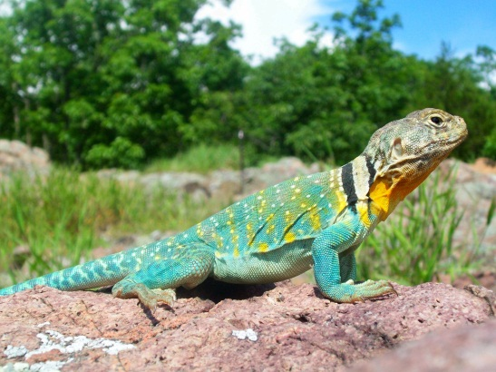
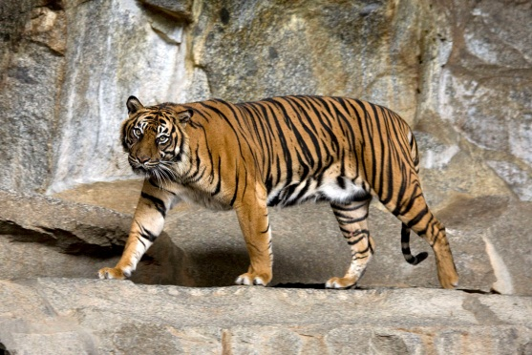
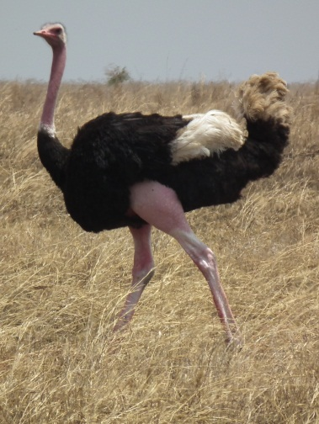
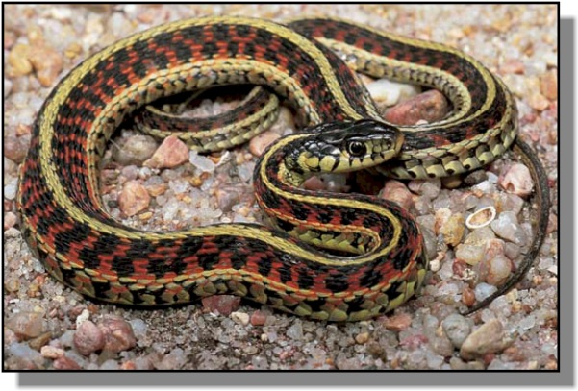
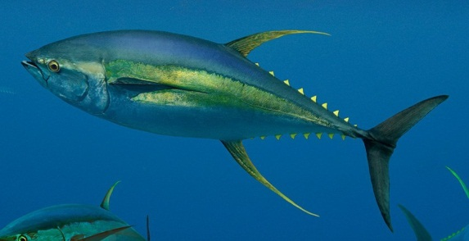
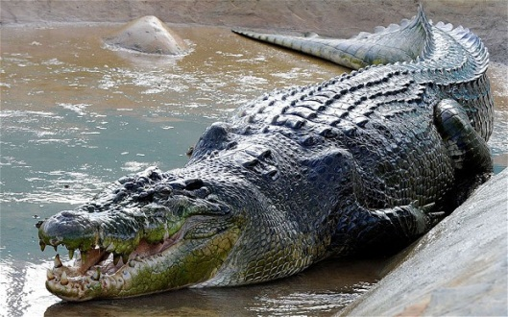
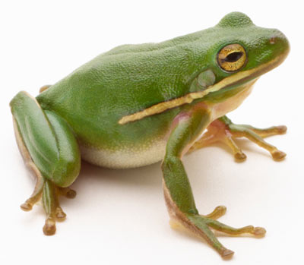
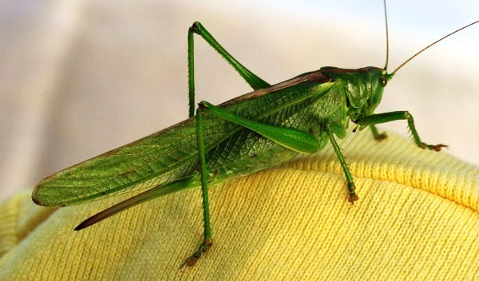
Notes:
Sorting animals

Slide 4
How have you grouped the animals?
All the animals .....................................
have are live run swim fly
Both the ................ and the ................................. have..................
have are live run swim fly
Choose two animals you have put together
Say what is different about them
The .................has ............... whereas the .................... has.................
has is lives runs swims flies

Slide 5
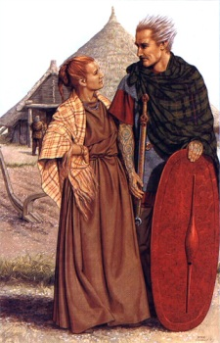
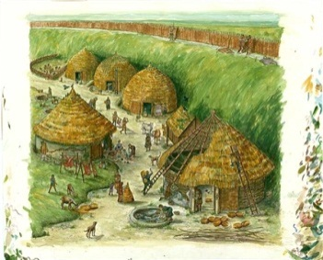
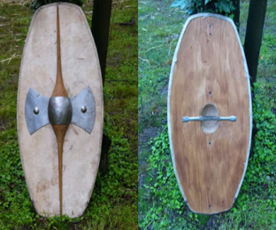
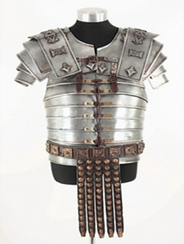
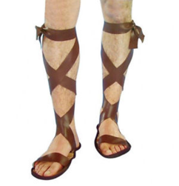
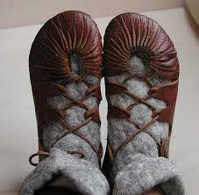
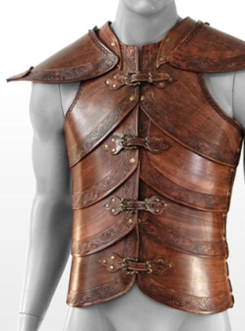
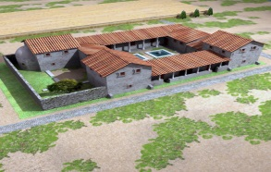
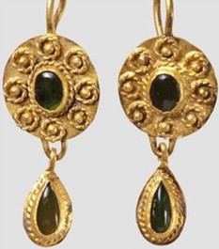
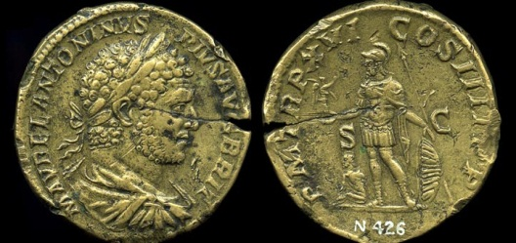
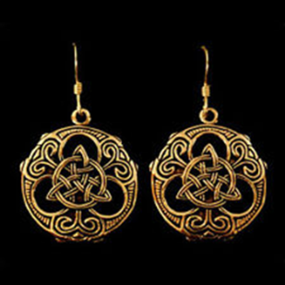
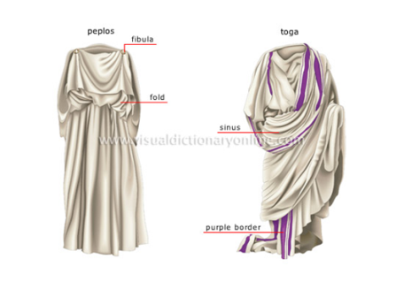
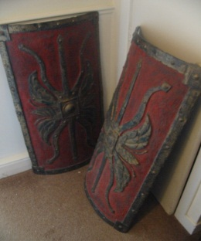
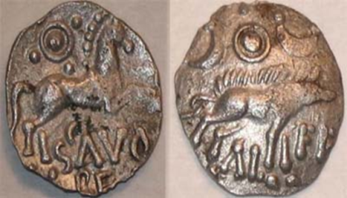
Here are some Celtic and Roman places and objects

Slide 6
Put the pictures of things which are similar in the right columns and rows
Celtic | Roman
 |  | they are both.......
 |  | they are both.......
 |  | they are both.......
 |  | they are both.......
 |  | they are both.......
 |  | they are both.......
 |  | they are both.......

Slide 7
Use these sentence structures to make your own sentences about Celtic and Roman places and things
Both the Celts and the Romans ..........
had were wore lived
They also both..............................

Slide 8
Take each pair of pictures.
Put one in the circle labelled Celtic.
Put the other in the circle labelled Roman.
Put all the other pictures in the right circle
Celtic
Roman

Slide 9
Can you take one similar picture from each circle.
Say what is different about them.
Use the sentence structure below.
Use the second sentence structure to make another sentence.
The Celts ........................whereas the Romans.................
The Celts ........................but the Romans.......................
Tell your partner something that is the same and something that is different about
A Celtic and Roman place or object.

